Slide 1
From Vagueness in Medical Thought to the Foundations of Fuzzy Reasoning in Medical Diagnosis
Rudolf Seising, Medical University of Vienna,
Artificial Intelligence in Medicine, 2006

Slide 2
Background
Medical decision-making:
The doctor notes the patient’s signs and symptoms;
Combines these with the patient’s medical history, physical examination and laboratory findings;
Diagnose the disease.

Slide 3
Background
Questions
How do physicians consider and treat potential diagnoses?
What is the medical way of thinking?
Can the process of medical diagnosis of medical diagnosis be described in a scientific model?
Why does he ignore some diagnoses and accept others as likely ones?
Model
Process
Likelihood

Slide 4
The fuzzy and uncertain nature of medical diagnostics
In a lecture on “some specific features of the medical way of thinking” in 1926, the young Polish medical scientist and philosopher Ludwik Fleck said:
Why, even the best diagnosticians are most frequently unable to give a specific basis for their diagnosis; they only explain that the entire appearance is characteristic of such or another disease.
Fuzzy, Uncertainty

Slide 5
Computer Programs Meets Medicine
In 1960s, to assist physicians in medical decision-making and patient care, medical expert systems use the theory of fuzzy sets and relations.

Slide 6
Computer Programs Meets Medicine
Fuzzy thinking
vs.
Logic Reasoning

Slide 7
Introduction to fuzzy set

Slide 8
Fuzzy Set Theory
Medicine was one of the first fields in which Lotfi Zadeh’s fuzzy set theory (1965) was applied.
Fuzzy set theory was used to deal with vagueness in perceptions of reality phenomena.
Expert Systems
MYCIN, INTERNIST, CASNET (1970s)

Slide 9
Fuzzy Set Theory
Lotfi A.Zadeh, University of California at Berkeley
Fuzzy Set
A class in which there may be a continuous infinity of grades of membership, with the grade of membership of an object x in a fuzzy set A represented by a number μ_{A}(x) in the interval [0, 1].
The membership of x in A: μ_{A}(x)
A process which plays a basic role in human thinking and communication.

Slide 10
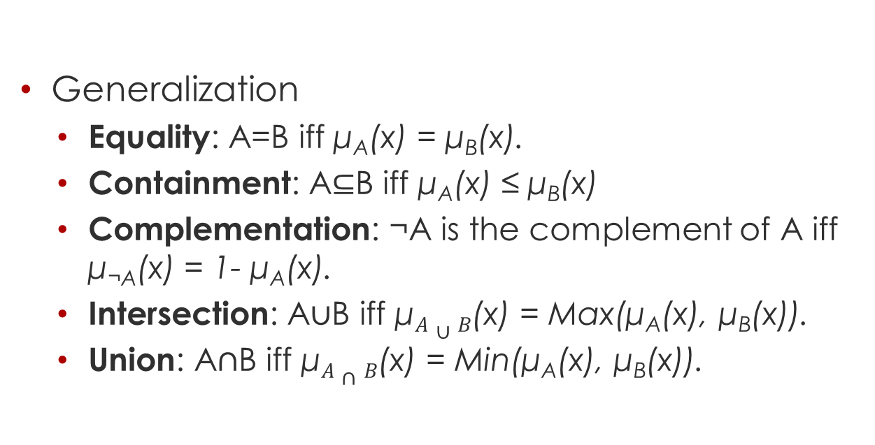
Fuzzy Set Theory
Generalization
Equality: A=B iff μ_{A}(x) = μ_{B}(x).
Containment: A$⊆$B iff μ_{A}(x) ≤ μ_{B}(x)
Complementation: ¬A is the complement of A iff μ_{¬A}(x) = 1- μ_{A}(x).
Intersection: A$∪$B iff μ$A∪B$(x) = Max(μ_{A}(x), μ_{B}(x)).
Union: A$∩$B iff μ$A∩B$(x) = Min(μ_{A}(x), μ_{B}(x)).

Slide 11
Linguistic Variables
Instances
Age: Young, very young, not very young, somewhat old, more or less young.
These values are formed from the label old, the negation not, and the hedges very, somewhat, and more or less.
These concepts relate to situations in which the source of imprecision is not a random variable or a stochastic process but rather a class or classes which do not possesses sharply defined boundaries.

Slide 12
Why use fuzzy set in Medicine

Slide 13
Vagueness in the medical way of thinking
Three aspects
There exists no strict boundary between what is healthy and what is diseased, and one never finds exactly the same clinical picture again.
How does one find a law for irregular phenomena? This is the fundamental problem of medical thinking.
It is very difficult to define sharp borders between various symptoms in the set of all symptoms and between various diseases in the set of diseases.

Slide 14
Vagueness in the medical way of thinking
Claim
Elements of medical knowledge, symptoms and diseases are essentially indeterminate, and that physicians count on their intuition rather than on logical consequences to deduce a disease from the patient’s data.

Slide 15
Fuzzy representation of Medicine

Slide 16
Fuzzy sets meets medicine
Disease-patient fuzziness
A human disease, e.g., diabetes, may be regarded as a fuzzy set in the following sense. Let X={x} denote the collection of human beings. Then diabetes is a fuzzy set, say D, in X, characterized by a membership function μ_{D}(x) which associates with each human being x his grade of membership in the fuzzy set of diabetes.

Slide 17
Fuzzy sets meets medicine
Disease-symptom fuzziness
The relation between diseases and various symptoms are fuzzy in nature. E.g., in the case of diabetes a fuzzy symptom may be, say, a hardening of the arteries.

Slide 18
Fuzzy sets meets medicine
Examples
A runny nose is almost always present in a common cold.
Acute pyelonephritis usually presents bladder irritation and infection.
Acute pyelonephritis presents occasionally fever, or chills, and malaise.
Representations
Common cold: D₁ / Acute pyelonephritis: D₂
Runny node, fever, bladder irritation, infection, chills, and malaise: S₁… S₆.

Slide 19
Fuzzy sets meets medicine
Fuzzy Relations
Low urine sodium concentration is almost always found in Hepatorenal Syndrome.
Relations: low, normal, high
Fuzzy Modifier
Qualifiers such as very, moderately, extremely, not, etc.
Logical operations
AND (min), OR (max)

Slide 20
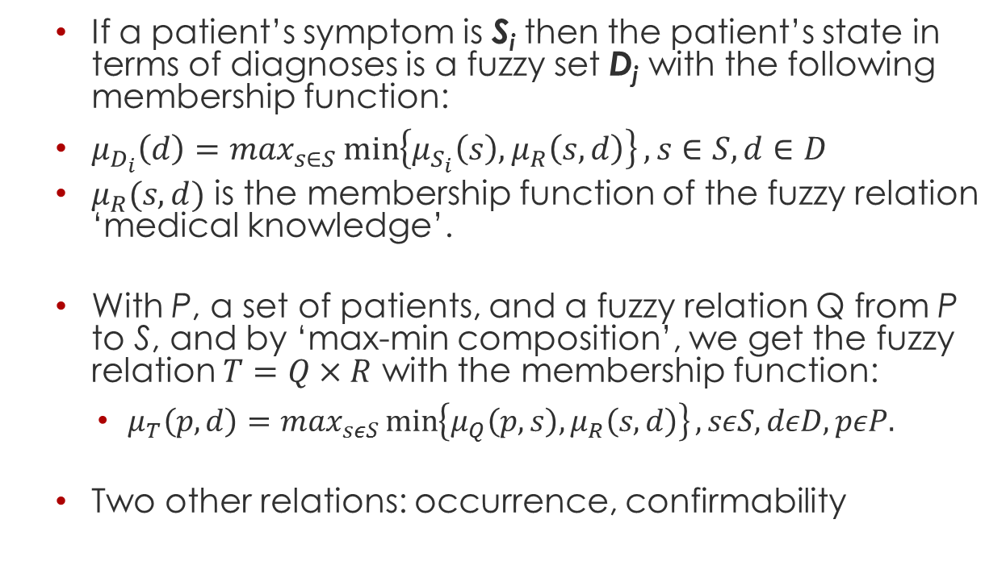
Fuzzy Medical Knowledge
If a patient’s symptom is S_{i} then the patient’s state in terms of diagnoses is a fuzzy set D_{j} with the following membership function:
$μ_{D_{i}}\left(d\right)=\max_{s∈S}\min\left\{μ_{S_{i}}\left(s\right), μ_{R}\left(s,d\right)\right\}, s∈S, d∈D$
$μ_{R}(s,d)$ is the membership function of the fuzzy relation ‘medical knowledge’.
With P, a set of patients, and a fuzzy relation Q from P to S, and by ‘max-min composition’, we get the fuzzy relation $T=Q×R$ with the membership function:
$μ_{T}\left(p, d\right)=\max_{sεS}\min\left\{μ_{Q}\left(p, s\right), μ_{R}\left(s, d\right)\right\}, sεS, dεD, pεP.$
Two other relations: occurrence, confirmability
Notes:
Occurrence (how often does S_{i}, occur with D_{j})
Confirmability(How strongly does S_{i}, confirm D_{j})

Slide 21
Inspirations

Slide 22
Fuzzy TCM
Already done
Symptom descriptions are fuzzy
Disease-symptom relations are somewhat fuzzy.
Plan to accomplish
Add fuzzy support into jena reasoner instead of fuzzy DL.
Add disease-patient fuzziness.
Add occurrence and confirmability to provide more convincible suggestions.
More ideas
Fuzzy Decision Tree
Fuzzy Graph

Slide 23
Thanks for your attention!

